Slide 1


FIRE ALARM SYSTEM USING ARDUINO
Sashikumar N Visweswaran A
Supervised by Ms. K Sudha

Slide 2
INTRODUCTION
Fire outbreak is a major concern in most of the places we visit. It is dangerous and requires high measures to avoid destruction and lives of property.
One of the preventive measures to avoid the danger is to install an automatic fire alarm at vulnerable locations.
This fire alarm system is capable of automatically detecting heat in each environment, sound an alarm and spray water to reduce the intensity of fire and open exhausts.

Slide 3
WHY OUR SYSTEM?
The existing fire alarm system in market nowadays is too complex in terms of design and structure.
Hence it needs regular maintenance to be carried out to make sure the system operates well. Regular maintenance also increases the cost of the system.
This fire alarm system which is implemented using Arduino has additional features and is highly cost effective and does not require regular maintenance.

Slide 4
COMPONENTS REQUIRED
Arduino UNO
Gas Sensor
16x2 LCD Display
Jumper Cables
LED patches
Breadboard
Piezo Buzzer
Arduino IDE

Slide 5
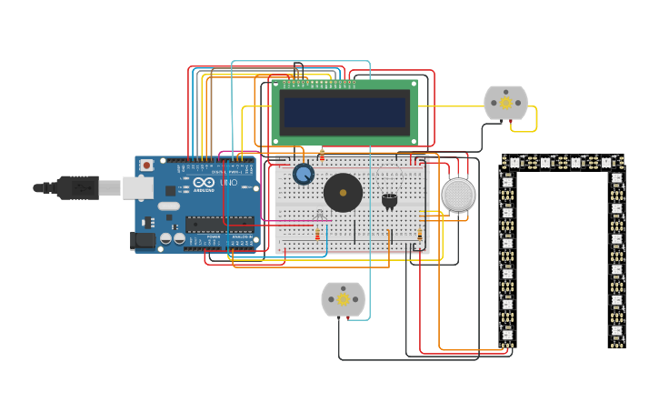
CIRCUIT DIAGRAM

Slide 6

WORKING

Slide 7
THANK YOU!

